Slide 1

P peline
The Data
Information Visualization Overview
© Jennifer Mankoff & Nikola Banovic
The Data Pipeline; HCII; Spring 2017
Slides cribbed from Marti Hearst http://courses.ischool.berkeley.edu/i247/f05/ (slides 2-10, 16, 19-21, 23, 25-37); Jian Huang, based on a tutorial by Daniel Kiem (slides 39-58); Beomjin Kin (11-14, 17-18)

Slide 2
Goals for today
Class feedback
Quiz 3
Light Overview of Info Viz:
Definition
Examples
Practice
Byte 3

Slide 3
Goals for today
Quiz 3 Code:
twonine

Slide 4
Goals
After this, you should be able to:
Understand key design goals for a visualization
Recognize positive properties of a visualization, such as telling a story and self-documenting
Discuss pros and cons of different evaluation approaches
Adapted from http://www.fordham.edu/economics/Vinod/correl-regr.ppt

Slide 5
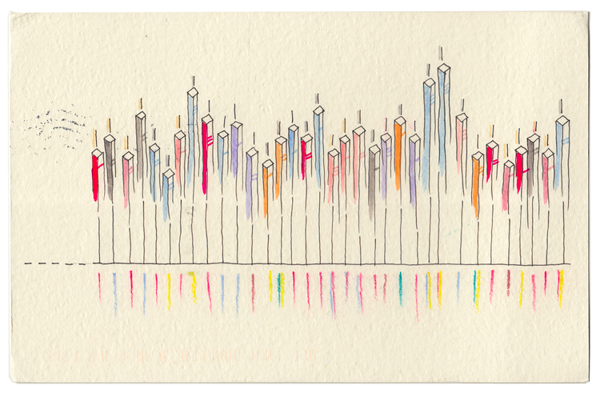
Dear Data
http://www.dear-data.com/all/

Slide 6
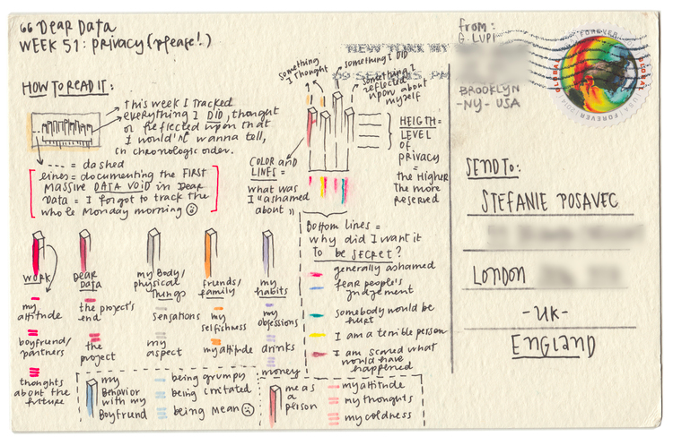
Dear Data

Slide 7
Dear Data
http://www.dear-data.com/all/

Slide 8
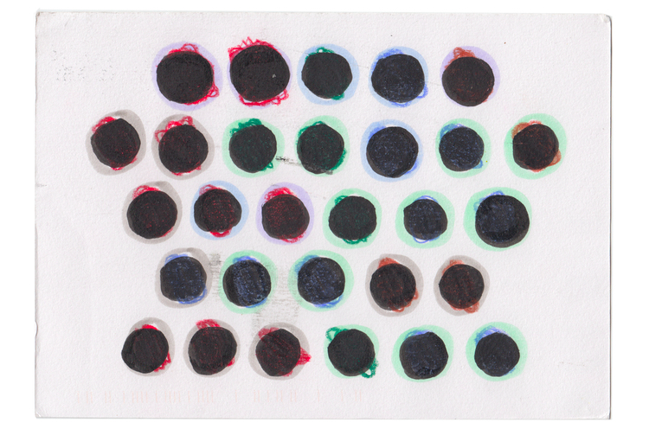
Dear Data

Slide 9
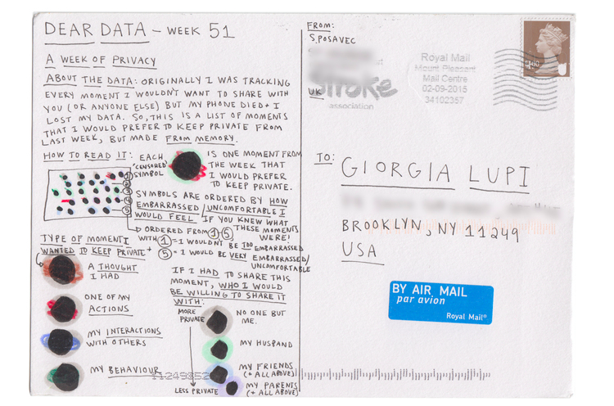
Dear Data

Slide 10
Dear Data

Slide 11
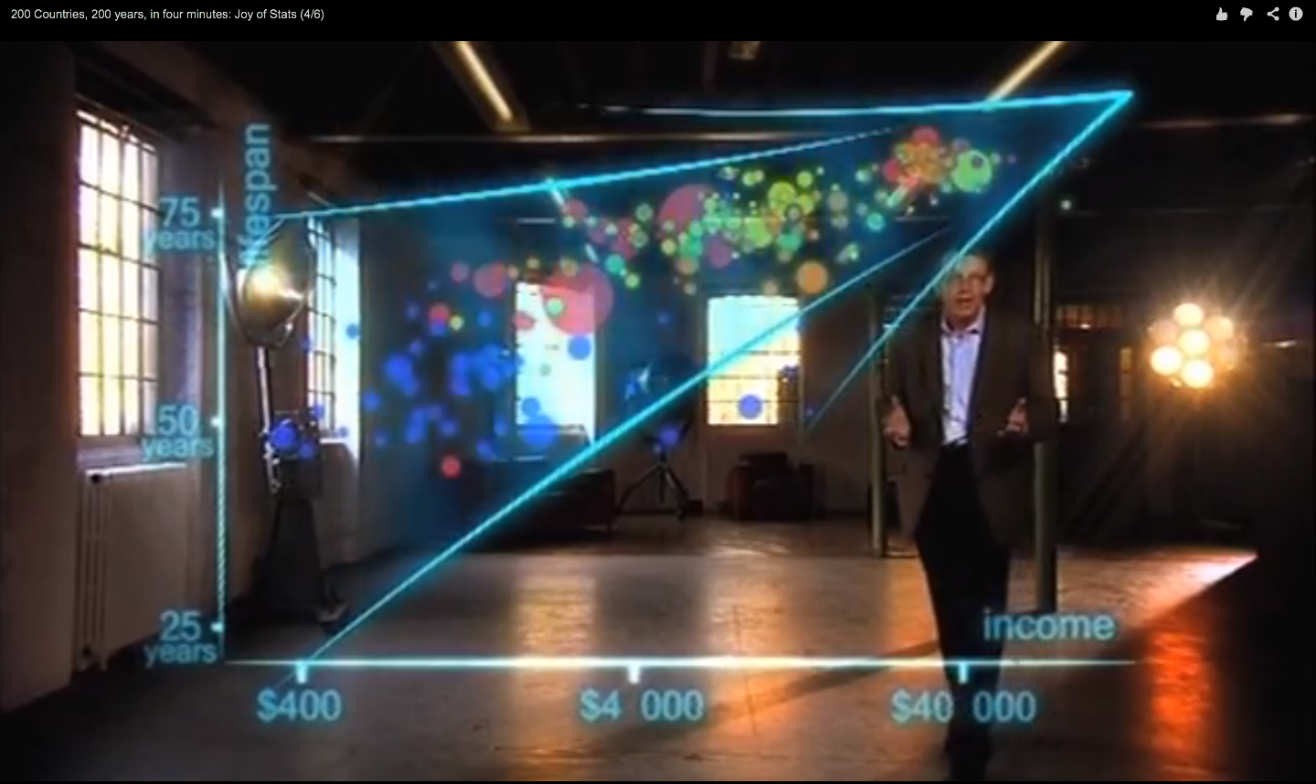
Hans Rosling on Health & Wealth
http://www.youtube.com/watch?v=ahp7QhbB8G4
Notes:
Tufte principals?
Comparisons
Causality, Mechanism, Structure, Explanation
Multivariate analysis
Integration of Evidence
Documentation
Content (Counts Most of All)

Slide 12
What is Information Visualization?
Visualize: to form a mental image or vision of …
Visualize: to imagine or remember as if actually seeing.
Notes:
American Heritage dictionary, Concise Oxford dictionary

Slide 13
What is Information Visualization?
The depiction of information using spatial or graphical representations, to facilitate comparison, pattern recognition, change detection, and other cognitive skills by making use of the visual system (Hearst 03).
Notes:
American Heritage dictionary, Concise Oxford dictionary

Slide 14
What is Information Visualization?
“that which gives to the viewer the greatest number of ideas in the shortest time with the least ink in the smallest space.” --Edward R. Tufte
Further Reading: http://fellinlovewithdata.com/guides/7-classic-foundational-vis-papers
Notes:
American Heritage dictionary, Concise Oxford dictionary

Slide 15
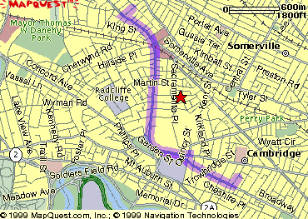
The Power of Visualization
1. Start out going Southwest on ELLSWORTH AVE
Towards BROADWAY by turning right.
2: Turn RIGHT onto BROADWAY.
3. Turn RIGHT onto QUINCY ST.
4. Turn LEFT onto CAMBRIDGE ST.
5. Turn SLIGHT RIGHT onto MASSACHUSETTS AVE.
6. Turn RIGHT onto RUSSELL ST.

Slide 16
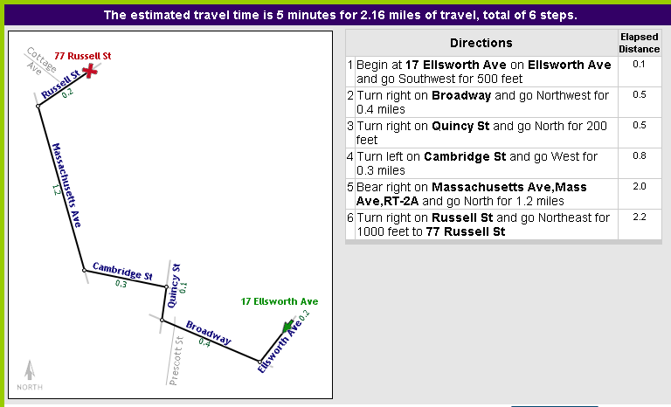
The Power of Visualization
Line drive tool by Maneesh Agrawala http://graphics.stanford.edu/~maneesh/

Slide 17
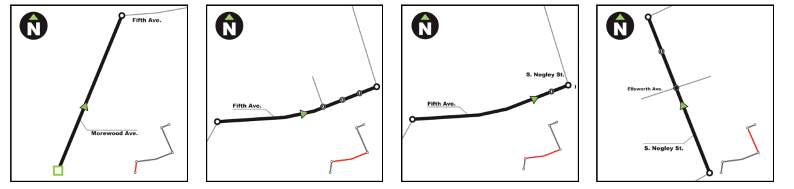
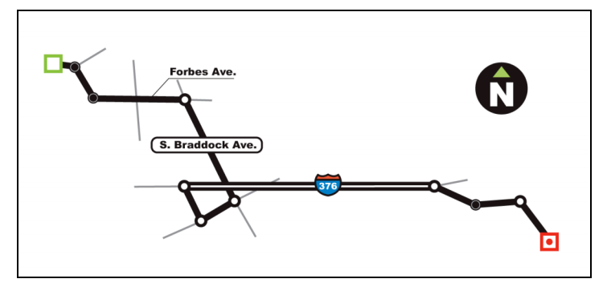
The Power of Design and interaction in Visualization
Lee, Forlizzi & Hudson

Slide 18
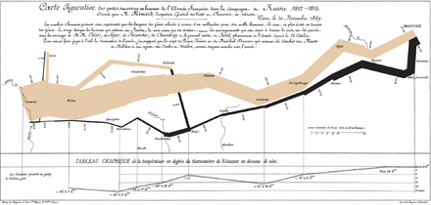
Narrative in Visualization
Documenting the question you are answering
Leading the viewer through a story
Example: http://projects.propublica.org/extinctions/
Notes:
Charles Joseph Minard's Carte Figurative illustrates facts related to Napoleon's 1812 Russian campaign.
He uses the term "data-ink ratio" to argue against using excessive decoration in visual displays of quantitative information

Slide 19
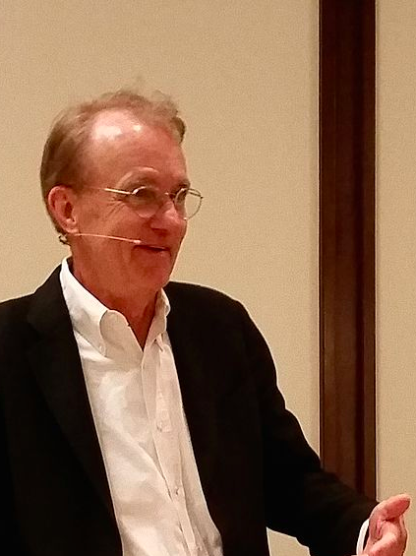
Planning a Visualization
What is its goal?
Does it support comparisons?
Causality, Mechanism, Structure, Explanation?
Multivariate analysis?
Integration of Evidence?
Documentation? [process & provenance]
Content (Most Important)
Tufte (Yale)
Notes:
Make large datasets coherent
Compact
Multivariate
Present information from various viewpoints
Support visual comparisons [Tufte]
Tell stories about the data (causality & structure...)
Have visual integration (images, words, etc.)
Document for credibility (baseline, scale, context)
But remember “analytical presentations ultimately stand or fail depending on the quality, relevance, and integrity of their content” [Tufte, Beautiful Evidence, p. 136]

Slide 20
Making Queries
Define the query[ies] you wish to support
“The special skill of designers … [is] the talent to analyze a design in terms of its ability to support the visual queries of others…”
Patterns ⬄ visual system
Cognitive process prediction
A continual fresh eye
Notes:
Topic for next class

Slide 21
Narrative in Visualization
Documenting the question you are answering
Leading the viewer through a story
Another Example: http://projects.propublica.org/extinctions/

Slide 22
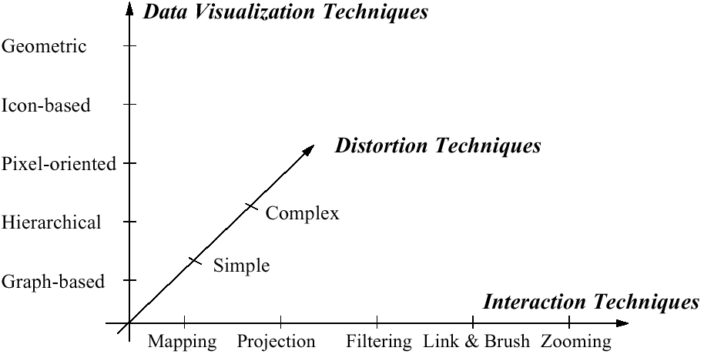
Visualization Techniques
http://www.visual-literacy.org/periodic_table/periodic_table.html
Notes:
nguyen

Slide 23
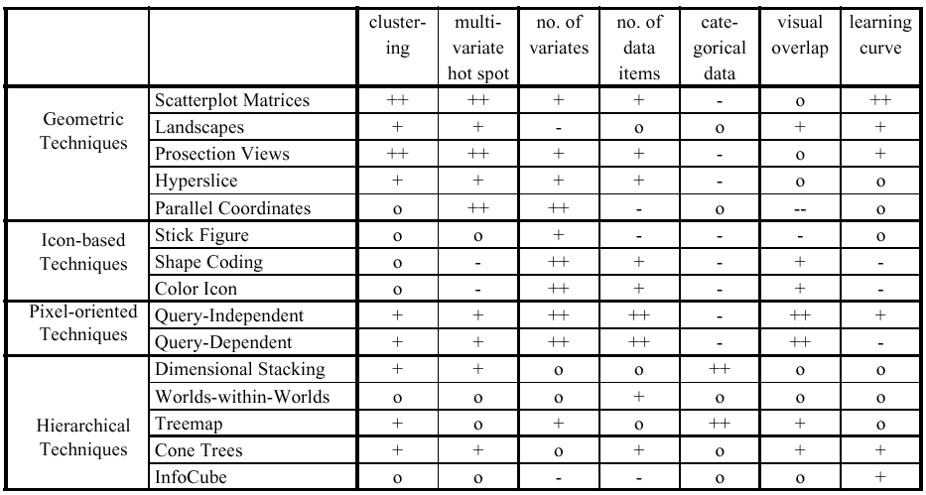
Comparison by Keim

Slide 24
The earth is getting warmer [which is closest to your view]: Create a viz
 | Sci. ‘14 | Sci. ‘09 | Aug 14 | Feb 14 | Oct 13 | Mar 13 | Oct 12 | Nov 11 | Feb 11 | Oct 10 | Sep 09 | April 09 | April 08 | Jan 07 | Aug 06 | Jul 06 | Jun 06
Mostly because of human activity | 87 | 84 | 50 | 40 | 44 | 42 | 42 | 38 | 36 | 34 | 36 | 49 | 47 | 47 | 47 | 50 | 41
Mostly because of natural patterns in the earth’s environment | 9 | 10 | 23 | 18 | 18 | 23 | 19 | 18 | 18 | 18 | 16 | 36 | 18 | 20 | 20 | 23 | 21
No solid evidence it is warming | 3 | 4 | 25 | 35 | 26 | 27 | 26 | 28 | 34 | 32 | 33 | 11 | 21 | 16 | 17 | 17 | 20
Don’t know/refused | 1 | 2 | 2 | 6 | 9 | 8 | 12 | 14 | 10 | 14 | 14 | 4 | 11 | 16 | 15 | 9 | 17

Slide 25
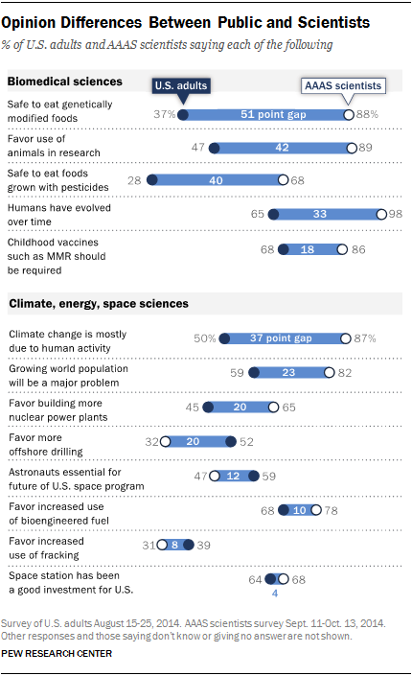
Notes:
Lightweight Visualization – what’s left out is as important as what is put in

Slide 26
Notes:
What’s even more important is what the ensured was included at the top and bottom…

Slide 27
Use of Animation in Visualization
http://www.bloomberg.com/graphics/2014-hottest-year-on-record/
Notes:
Tufte principals:
Comparisons
Causality, Mechanism, Structure, Explanation
Multivariate analysis
Integration of Evidence
Documentation
Content (Counts Most of All)

Slide 28

Simple, Interactive, Informative
https://fivethirtyeight.com/features/gun-deaths/

Slide 29
Does visualization help?
The jury is still out
Still supplemental at best for text collections
A correlation with spatial ability
Learning effects: with practice ability on visual display begins to equal that of text
Notes:
Realism vs Precision
Generalizability vs Contextualization

Slide 30
Other great visualizations:
A day in the life: http://flowingdata.com/2015/12/15/a-day-in-the-life-of-americans/ Alternative view of how different groups spend their days
US thanksgiving flights
Syrian conflict relationships explained
Boston’s subway system in small multiples

